Slide 1
辐照 vs 非辐照
李桃
2020/5/19

Slide 2
Irradiated
Non-irradiated
Surface roughness
Non-irradiated: 12.262 nm
Irradiated: 15.575 nm
Morphology
Morphology
Potential histogram
52mV
309mV
Surface Potential
(Mean values after Gaussian fitting are labelled.)

Slide 3
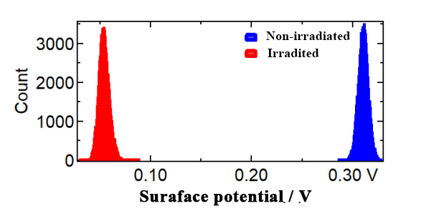
Non-irradiated
Irradiated
(a)
(b)
Potential histogram
(c)

